Slide 1
Data Base Management System Unit -3

Slide 2
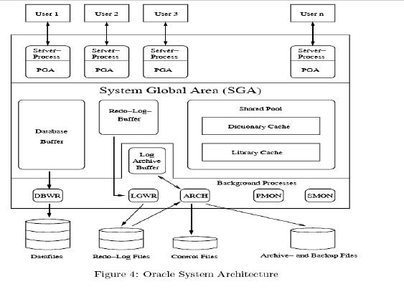
Oracle 8 Architecture

Slide 3
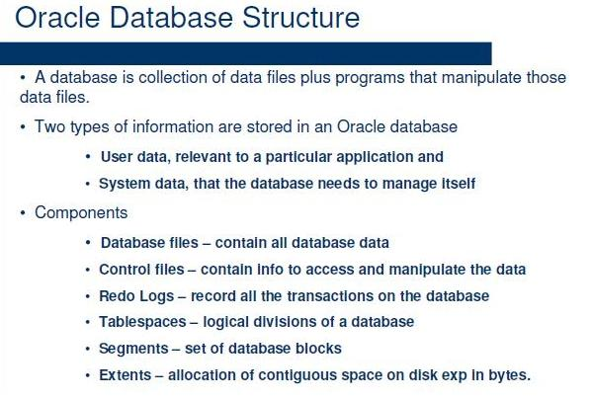
Oracle Database Structure

Slide 4
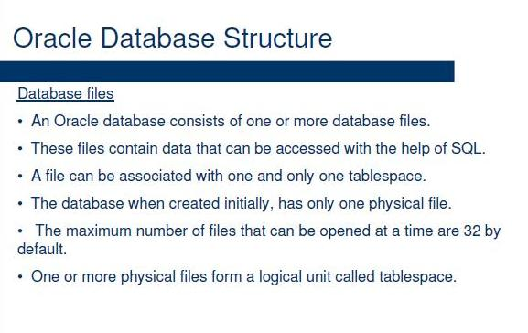
Database Files

Slide 5
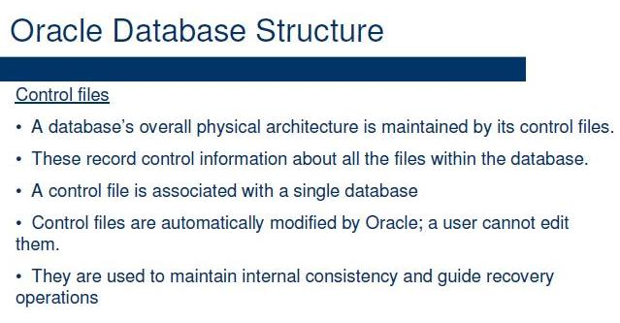
Control Files

Slide 6
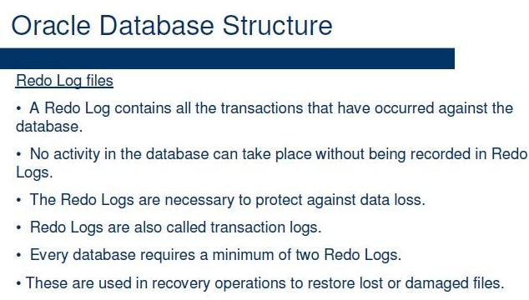
Redo Log files

Slide 7
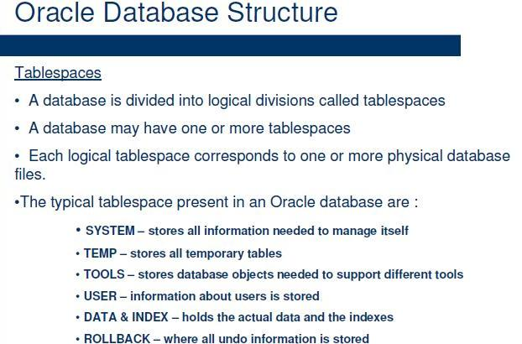
Table Spaces

Slide 8
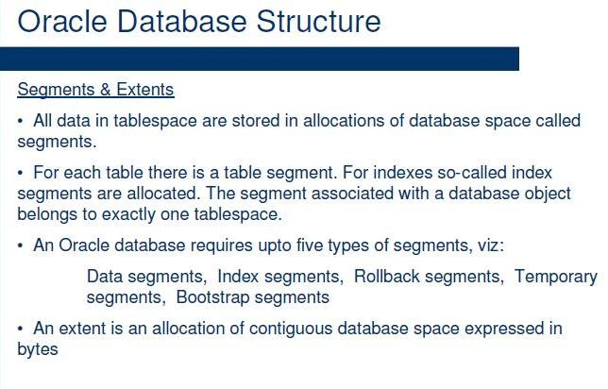
Segments

Slide 9
Blocks
An extent consists of one or more contiguous Oracle data blocks.
A block determines the finest level of granularity of where data can be stored.
One data block corresponds to a specific number of bytes of physical database space on disk.
A data block size is specified for each Oracle database when the database is created. A database uses and allocates free database space in Oracle data blocks.
Information about data blocks can be retrieved from the data dictionary views USER SEGMENTS and USER EXTENTS. These views show how many blocks are allocated for a database object and how many blocks are available (free) in a segment/extent,

Slide 10
Archive/Backup Files
If an instance is running in the archive-log mode, the ARCH process archives the modifications of the redo-log files in extra archive or backup files. In contrast to redo-log files, these files are typically not overwritten.

Slide 11
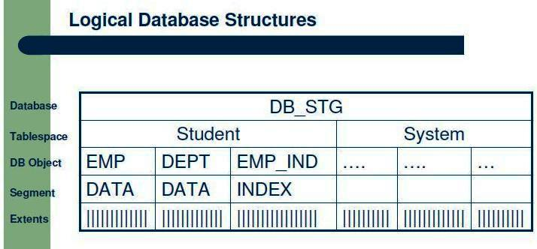
Oracle Software Structure
For the architecture of an Oracle database we distinguish between logical and physical database structures that make up a database.
Physical structures, in contrast, are determined by the operating system files that constitute the database.
Logical structures describe logical areas of storage (name spaces) where objects such as tables can be stored. The logical database structures include:

Slide 12
Physical Database Structure
The physical database structure of an Oracle database is determined by files and data blocks:
Data Files
A tablespace consists of one or more operating system files that are stored on disk. Thus a database essentially is a collection of data files that can be stored on different storage. devices (magnetic tape, optical disks etc.). Typically, only magnetic disks are used. Multiple data files for a tablespace allows the server to distribute a database object over multiple disks (depending on the size of the object).

Slide 13
SGA
System global area (SGA)
The SGA is a group of shared memory structures, known as SGA components, that contain data and control information for one Oracle Database instance. The SGA is shared by all server and background processes.
Oracle Database automatically allocates memory for an SGA when you start an instance, and the operating system reclaims the memory when you shut down the instance. Each instance has its own SGA.
The SGA is read/write. All database background processes and all server processes that execute on behalf of users can read information contained within the instance's SGA, and several processes write to the SGA during database operation.
The most important SGA components are the following:
Database Buffer Cache
Redo Log Buffer
Shared Pool
Large Pool
Java Pool
Streams Pool

Slide 14
PGA
Program global area (PGA)
A PGA is a memory region that contains data and control information for a server process. It is nonshared memory created by Oracle Database when a server process is started. Access to the PGA is exclusive to the server process. There is one PGA for each server process. Background processes also allocate their own PGAs.

Slide 15
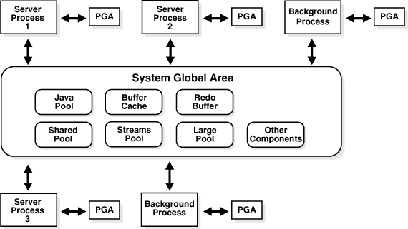
SGA & PGA

Slide 16
Database Buffer
Database Buffer
The database buffer is a cache in the SGA used to hold the data blocks that are read from data files.
Blocks can contain table data, index data etc. Data blocks are modified in the database buffer.
Oracle manages the space available in the database buffer by using a least recently used (LRU) algorithm. When free space is needed in the buffer, the least recently used blocks will be written out to the data files.
The size of the database buffer has a major impact on the overall performance of a database.

Slide 17
Redo-Log-Buffer
Redo-Log-Buffer
This buffer contains information about changes of data blocks in the database buffer. While the redo-log-buffer is filled during data modifications, the log writer process writes information about the modifications to the redo-log files. These files are used after, e.g., a system crash, in order to restore the database (database recovery).

Slide 18
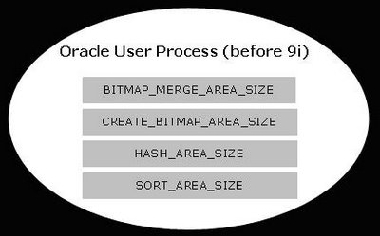
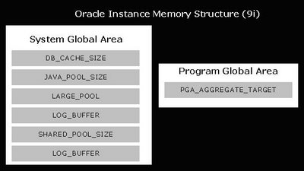
Oracle 11g Memory Management

Slide 19

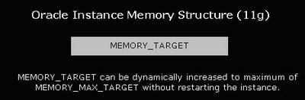
Oracle 11g Memory Management

Slide 20
Oracle 11g Memory Management
MEMORY_TARGET can be dynamically increased to a maximum of MEMORY_MAX_TARGET without restarting the instance.
MEMORY_TARGET specifies the Oracle system wide usable memory.
MEMORY_MAX_TARGET specifies the maximum value to which a DBA can set the MEMORY_TARGET.
The database tunes memory to the MEMORY_TARGET value, reducing or enlarging the SGA and PGA as needed.
If SGA_TARGET and PGA_AGGREGATE_TARGET are not set, it will distribute the total server memory in the ration of 60 – 40.
60 % to SGA_TARGET and
40 % to PGA_AGGREGATE_TARGET
If both are set then SGA + PGA_AGGREGATE_TARGET <= MEMORY_TARGET.

Slide 21
Structural Query Language (SQL) Unit -2
5/5/2014
21
Notes:
21
21

Slide 22
Structured Query Language
SQL is a language that provides an interface to relational database system.
SQL was developed by IBM in the 1970’s.
SQL is often pronounced as SEQUEL.
SQL is divided into 4 type of queries.
DDL – Data Definition Language
DML – Data Manipulation language
DQL – Data Query Language
DCL – Data Control Language

Slide 23
SQL- Queries
DDL
Create
Alter
Drop
Truncate
DML
Insert
Update
Delete
DCL
Commit
Rollback
Save point
Set transaction
DQL
Select

Slide 24
To Create a Table
Create table student
( rollno number(5),
name char(15),
address varchar2(25));
SQL> create table student
(rollno number(5),
name char(15),
address varchar2(25));
Table created.
5/5/2014
24

Slide 25
Description of the table
Desc student;
SQL>Desc student;
Name Null? Type
--------------------------------- -------- ----------------------------
ROLLNO NUMBER(5)
NAME CHAR(15)
ADDRESS VARCHAR2(25)
5/5/2014
25

Slide 26
Insert a record into student table
Insert into student
Values(101,’Rahul’,’patel nagar Delhi’);
SQL> Insert into student
Values(101,'Rahul','patel nagar Delhi');
1 row created.
5/5/2014
26

Slide 27
Insert multiple record into table
Insert into student
Values(&rollno,’&name’,&address’);
SQL> Insert into student
Values(&rollno,'&name','&address');
Enter value for rollno: 102
Enter value for name: sachin
Enter value for address: raj nagar ghaziabad
old 2: Values(&rollno,'&name','&address')
new 2: Values(102,'sachin','raj nagar ghaziabad')
1 row created.
SQL> /
Enter value for rollno: 103
Enter value for name: amit
5/5/2014
27

Slide 28
Different way to Look the Record
Select * from student;
Select name from student;
Select name from student
where rollno=100;
Select name from student
Where rollno between 100 and 101;

Slide 29
Different way to Look the Record
Select name from student
where rollno=100 and address =‘patel nagar delhi’;
Select name from student
where rollno=100 or address =‘patel nagar delhi’;
Select count (name) from student;
Select name from student
Where rollno in(100,101);

Slide 30
To look All the column
Select * from student;
Output:
SQL> Select * from student;
ROLLNO NAME ADDRESS
---------- --------------- -------------------------
100 Rahul patel nagar Delhi
101 Rahul patel nagar Delhi

Slide 31
Selected column Record
Select name from student;
Output:
SQL> Select name from student;
NAME
---------------
Rahul
Rahul
5/5/2014
31

Slide 32
Use of Operators (>,<,=,!=)
Select name from student
Where rollno=100;
Output:
SQL> Select name from student
Where rollno=100;
NAME
---------------
Rahul
5/5/2014
32

Slide 33
Use of between
Select name from student
Where rollno between 100 and 101;
Output:
SQL> Select name from student
Where rollno between 100 and 101;
NAME
---------------
Rahul
Rahul
5/5/2014
33

Slide 34
Use of like
Select name from student
Where name like ‘%a%’
Output:
SQL> Select name from student
Where name like ‘%a%’
NAME
---------------
Rahul
Rahul
5/5/2014
34

Slide 35
Use of in
Select name from student
Where rollno in (100,101,102);
Output:
SQL> Select name from student
Where rollno in (100,101,102);
NAME
---------------
Rahul
sachin
5/5/2014
35

Slide 36
Use of Distinct
Select distinct name from student ;
Output:
SQL> select distinct name from student;
NAME
---------------
Rahul
amit
sachin
5/5/2014
36

Slide 37
Use of And
Select name,address from student
Where rollno=101 and name =‘Rahul’;
Output:
SQL> Select name,address from student
Where rollno=101 and name ='Rahul';
NAME ADDRESS
--------------- -------------------------
Rahul patel nagar Delhi
5/5/2014
37

Slide 38
Use of OR
Select name,address from student
Where rollno=101 or name =‘Rahul’;
Output:
SQL> Select name,address from student
Where rollno=101 or name ='Rahul';
NAME ADDRESS
--------------- -------------------------
Rahul raj nagar delhi
Rahul patel nagar Delhi
5/5/2014
38

Slide 39
Use of Group By
select name from student group by name;
Output:
SQL> select name from student group by name;
NAME
---------------
Rahul
amit
sachin
Only unique entries will display, duplicate values will not show
5/5/2014
39

Slide 40
Use of Order By
select rollno,name from student
Order by rollno;
Output:
SQL> SELECT rollno,name from student
ORDER BY rollno;
ROLLNO NAME
---------- ---------------
100 Rahul
101 Rahul
102 sachin
103 amit
Order by will place the records in descending order by default
5/5/2014
40

Slide 41
Use of like
Select name from student
Where name like '_a%' or name like '_m%'
Output:
SQL> Select name from student
Where name like '_a%' or name like '_m%';
NAME
---------------
Rahul
Rahul
sachin
amit
5/5/2014
41

Slide 42
Use of Not in ()
Select name from student
Where rollno not in (100,101,102);
Output:
SQL> Select name from student
Where rollno not in (100,101,102);
NAME
---------------
Rahul
amit
5/5/2014
42

Slide 43
Use of Not in with character
Select name from student
Where name not in (‘Rahul’,’amit’);
Output:
SQL> Select name from student
Where name not in('Rahul','amit');
NAME
---------------
sachin
5/5/2014
43

Slide 44
Update Record for all records
Update student
Set name =‘Aman’;
Output:
SQL> Update temp
Set name ='Aman';
4 rows updated.
Update command will update the name Aman to all records
5/5/2014
44

Slide 45
Update Record for a record
Update student Set name =‘Aman’
Where rollno=100;
Output:
SQL> Update student
Set name ='Aman'
Where rollno=100;
1 row updated.
Update command will update the name Aman where rollno=100.
5/5/2014
45

Slide 46
Update Record – Multi column
Update student
Set name =‘Aman’ ,address=‘India gate’
Where rollno=101;
Output:
SQL> Update student
Set name ='Aman',address='India gate'
Where rollno=101;
1 row updated.
Update command will update the name Aman and address= India gate where rollno=101.

Slide 47
Delete record
Delete from student;
Output:
SQL> Delete from student;
4 rows deleted.
Delete command will delete all the records of the table
5/5/2014
47

Slide 48
Delete record based on condition
Delete from student Where rollno=100;
Output:
SQL> Delete from student
Where rollno=100;
1 row deleted.
This command will delete the records where rollno is 100.
5/5/2014
48

Slide 49
Alter the structure of the table
Add:- used to add any column or constraints
Modify:- used to change the existing structure of the table like column size or changing data type etc.
Drop :- used to delete a column
5/5/2014
49

Slide 50
Alter the structure with add
Alter table student
Add subject number(2);
Output:
SQL> Alter table student
Add subject number(2);
Table altered.
Add command will add the column ‘subject’ with number(2)
5/5/2014
50

Slide 51
Alter with not null constraint
Alter table new
Add book number(2) not null;
Output:
SQL> ed
Wrote file afiedt.buf
1 Alter table new
2* Add book number(2) not null
SQL> /
Table altered.
But the table
should be empty
at that time
5/5/2014
51

Slide 52
Alter with check constraint
Alter table new
Add ms char(2) check (ms in (‘m’,’u’));
Output:
SQL> ed
Wrote file afiedt.buf
1 Alter table new
2* Add ms char(2) check (ms in ('m','u'))
SQL> /
Table altered.
5/5/2014
52

Slide 53
Alter with default constraint
Alter table new
Add price number(2) default 0;
Output:
SQL> Alter table new
Add price number(2) default 0;
Table altered.
5/5/2014
53

Slide 54
Alter the structure with modify
Alter table student
Modify subject number(3);
Output:
SQL> Alter table student
Modify subject number(3);
Table altered.
This command will modify the column ‘subject’ to number(3) while before this the size was 2
5/5/2014
54

Slide 55
Alter the structure with Drop
Alter table student
Drop column subject;
Output:
SQL> Alter table student
Drop column subject;
Table altered.
This command will drop or delete the column ‘subject’
5/5/2014
55

Slide 56
Truncate Record
Truncate table student;
Output:
SQL> truncate table student;
Table truncated.
Truncate will delete all the records and structure of table will remain same
5/5/2014
56

Slide 57
Drop Record
Drop table student;
Output:
SQL> drop table student;
Table dropped.
Drop command will delete all the data and structure of the table too.
5/5/2014
57

Slide 58
Rename to the table
Rename student to newstudent;
Output:
SQL> Rename student to newstudent;
Table renamed.
Rename command will change the name of the table
5/5/2014
58

Slide 59
Creating a table from a table
create table new_student as select * from student;
Output:
SQL> create table new_student as select * from student;
Table created..
As command will create the same table as student and put the record in new_student table.
5/5/2014
59

Slide 60
Inserting all records from one table to another table
SQL> insert into student
select * from new_student;
Output:
SQL> insert into student
select * from new_student;
4 rows created.
This command will copy all the data of new_student table to student table.
5/5/2014
60

Slide 61
Spool on & spool off
SQL> spool c:\abc.txt
SQL> spool off
This is used to store all the command which are running on sql at present and save it into the given file name
5/5/2014
61

Slide 62
Use of Commit
To save the all the changes in records which has done till now.
Output:
SQL> commit;
Commit complete.
5/5/2014
62

Slide 63
Some of the important SQL functions
Avg
Max
Min
Count
Sum
Abs
Power
Round
Sqrt
Exp
Greatest
Least
Mod
Trunc
Floor
ceil

Slide 64
Use of Avg() function
select avg(rollno) from student;
Output:
SQL> select avg(rollno) from student;
AVG(ROLLNO)
-----------
102.5

Slide 65
Use of max() function
select max(rollno) from student;
Output:
SQL> select max(rollno) from student;
MAX(ROLLNO)
-----------
104

Slide 66
Use of min() function
select min(rollno) from student;
Output:
SQL> select min(rollno) from student;
MIN(ROLLNO)
-----------
100

Slide 67
Use of count() function
select count(rollno) from student;
Output:
SQL> select count(*) from student;
COUNT(*)
----------
4

Slide 68
Use of sum() function
select sum(rollno) from student;
Output:
SQL> select sum(rollno) from student;
SUM(ROLLNO)
-----------
410

Slide 69
Use of abs() function
select abs(-20) from dual;
Output:
SQL> select abs(-20) from dual;
ABS(-20)
----------
20

Slide 70
Use of power() function
select power(3,2) from dual;
Output:
SQL> select power(3,2) from dual;
POWER(3,2)
----------
9

Slide 71
Use of round() function
select round(100.19,1) from dual;
Output:
SQL> select round(100.19,1) from dual;
ROUND(100.19,1)
---------------
100.2

Slide 72
Use of sqrt() function
select sqrt(36) from dual;
Output:
SQL> select sqrt(36) from dual;
SQRT(36)
----------
6

Slide 73
Use of greatest() function
select greatest(10,20,30) from dual;
Output:
SQL> select greatest(10,20,30) from dual;
GREATEST(10,20,30)
------------------
30

Slide 74
Use of greatest() function
select greatest(10,20,30) from dual;
Output:
SQL> select greatest(10,20,30) from dual;
GREATEST(10,20,30)
------------------
30

Slide 75
Use of least() function
select least(10,20,30) from dual;
Output:
SQL> select least(10,20,30) from dual;
LEAST(10,20,30)
------------------
10

Slide 76
Use of mod() function
select mod(21,10) from dual;
Output:
SQL> select mod(21,10) from dual;
MOD(21,10)
----------
1

Slide 77
Use of trunc() function
select trunc(100.181,1) from dual;
select trunc(101.181,-2) from dual
Output:
SQL> select trunc(100.181,1) from dual;
TRUNC(100.181,1)
----------------
100.1

Slide 78
Use of trunc() function
select trunc(100.181,1) from dual;
select trunc(101.181,-2) from dual
Output:
SQL> select trunc(100.181,1) from dual;
TRUNC(100.181,1)
----------------
100.1

Slide 79
Use of floor() function
select floor(30.9) from dual;
Returns the largest integer value that is equal to or less than a number
Output:
SQL> select floor(30.9) from dual;
FLOOR(30.9)
-----------
30

Slide 80
Use of ceil() function
select ceil(30.9) from dual;
Returns the smallest integer value that is equal to or greater than a number
Output:
SQL> select ceil(30.9) from dual;
CEIL(30.9)
----------
31

Slide 81
String Function
Lower
Upper
Init
Substr
Ascii
Length
Ltrim
Rtrim

Slide 82
Use of lower() function
select lower(‘SACHIN’) from dual;
Output:
SQL> select lower('SACHIN') From dual;
LOWER
------
sachin

Slide 83
Use of upper() function
select upper(‘sachin’) from dual;
Output:
SQL> select upper('sachin') from dual;
UPPER(
------
SACHIN

Slide 84
Use of initcap() function
select initcap(‘sachin’) from dual;
Output:
SQL> select initcap('sACHIN') FROM DUAL;
INITCA
------
Sachin

Slide 85
Use of substr() function
select substr(‘sachin’,3,2) from dual;
Output:
SQL> select substr('sachin',3,2) from dual;
SU
--
ch

Slide 86
Use of ASCII() function
select ascii(‘a’),ascii(‘A’) from dual;
Output:
SQL> select ascii('a'),ascii('A') from dual;
ASCII('A') ASCII('A')
---------- ----------
97 65

Slide 87
Use of length() function
select length(‘hello’) from dual;
Output:
SQL> select length('hello') from dual;
LENGTH('HELLO')
---------------
5

Slide 88
Use of ltrim() function
select ltrim(‘hello’,’he’) from dual;
Output:
SQL> select ltrim('hello','he') from dual;
LTR
---
llo

Slide 89
Use of Rtrim() function
select rtrim(‘hello’,’ol’) from dual;
Output:
SQL> select rtrim('hello','o') from dual;
RTRI
----
hell

Slide 90
Use of trim() function
select trim(leading 'x' from 'xxxxxhelloxxx') from dual;
select trim(both 'x' from 'xxxxxhelloxxx') from dual;
Output:
SQL> select trim(leading 'x' from 'xxxxxhelloxxx') from dual;
TRIM(LEA
--------
helloxxx

Slide 91
Date Function
Add_months
Last_day
Months_between
Next_day

Slide 92
Use of add_months() function
select add_months(sysdate,2) from dual;
Output:
SQL> select add_months(sysdate,2) from dual;
ADD_MONTH
---------
05-OCT-10

Slide 93
Use of last_day() function
select sysdate,last_day(sysdate) from dual;
Output:
SQL> select sysdate,last_day(sysdate) from dual;
SYSDATE LAST_DAY(
--------- ---------
05-AUG-10 31-AUG-10

Slide 94
Use of months_between() function
select months_between(‘5-aug-2010’,’5-sep-2010’) from dual;
Output:
SQL> select months_between('5-oct-2010','5-aug-2010') from dual;
MONTHS_BETWEEN('5-OCT-2010','5-AUG-2010')
-----------------------------------------
2

Slide 95
Use of next_day() function
select next_day('5-aug-2010‘,’Sunday’) from dual;
Output:
SQL> select next_day('5-aug-2010','sunday') from dual;
NEXT_DAY(
---------
08-AUG-10

Slide 96
Use of next_day() function
select next_day('5-aug-2010‘,’Sunday’) from dual;
Output:
SQL> select next_day('5-aug-2010','sunday') from dual;
NEXT_DAY(
---------
08-AUG-10

Slide 97
Why we add primary key
Primary key = unique + not null
A table can contain only one primary key
But can contain many foreign keys

Slide 98
Add / modify / drop Primary Key
Alter table student
Add rollno number(5) primary key;
Alter table student
Modify rollno primary key;
Alter table student
Drop primary key;

Slide 99
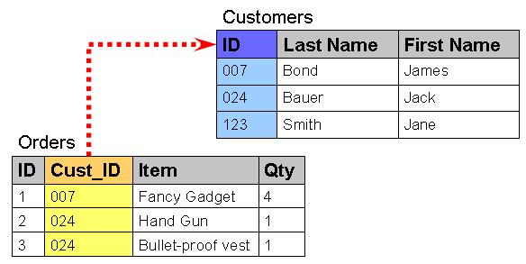
Why we add Foreign key
Foreign key represent relationships between tables.
A foreign key is a column( or group of column) whose values are derived from the primary key of some other table.

Slide 100
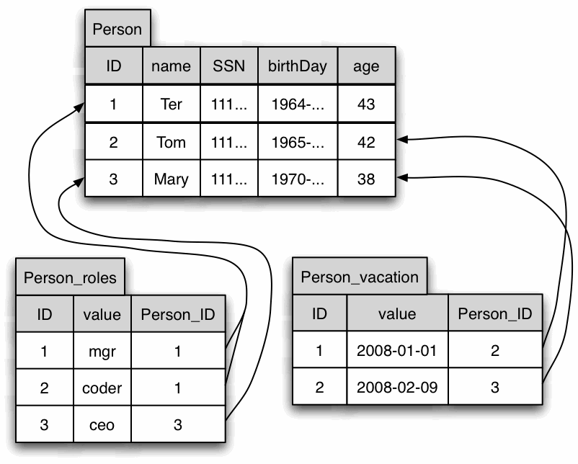
Foreign key Example

Slide 101
Add / drop Foreign key
CREATE TABLE student
(rollno number(5) primary key, name char(15), lib_id number(3) references lib(lib_id));
Alter table student
add constraint f_key foreign key(lib_id) references lib(lib_id)
Alter table student
Drop constraint f_key;

Slide 102
Views
Creating Views
Select view
Update views
Delete views
Insert views
Drop views
Use:
To reduce redundant data
To preventing all users from accessing all the column of a table

Slide 103
Creating view – all columns
Create view vstu as select * from student;
Check that view is created or not by
Select * from tab;

Slide 104
Creating view – selected columns
Create view vstudent as
select rollno,name from student;
Only two columns can be accessed by the user of view - vstudent

Slide 105
Viewing the record via views
Select * from vstudent;

Slide 106
Inserting values to view
Insert into vstudent values(110,’rohit’);
Check the record in student table now
Output:
SQL> Insert into vstudent values(110,'rohit');
1 row created.

Slide 107
Updating view
update vstudent set name=‘rahul’ where rollno=110;
Check the record in student table now
Output:
SQL> update vstudent set name='rahul' where rollno=110;
1 row updated.

Slide 108
Deleting the record from view
Delete from vstudent where name=‘rahul’;
Check the record in student table now
Output:
SQL> Delete from vstudent where name='rahul';
1 row deleted.

Slide 109
Drop view
Drop view vstudent;
Check that no effect on student table;
Output:
SQL> Drop view vstudent;
View dropped.

Slide 110
View with multiple table
create view vstudent as select name,bookname from student,lib;
Here student and lib both are separate table
Bookname column is taken from lib
Output:
SQL> create view vstudent as select name,bookname from student,lib;
View created.

Slide 111
Inserting values in multiple table view
insert into vstudent values('amit','data structure');
To remove this error we have to use joins
Output:
SQL> insert into vstudent values('amit','data structure');
insert into vstudent values('amit','data structure')
*
ERROR at line 1:
ORA-01779: cannot modify a column which maps to a non key-preserved table

Slide 112
Sub queries
Query with in query is known as sub queries or nested query.
Like:
select a.name,b.book from student a,lib b where a.rollno in ( select rollno from lib)

Slide 113
List customers holding fixed deposits in the bank of amount more than 5,000
Tables given:
Cust_mstr : cust_no, fname, lname
Acct_fd_cust_dtls : cust_no, Acct_fd_no
Fd_dtls : fd_ser_no, amt
Select ( fname || ‘ ‘ ||Lname) “customer” from cust_mstr where cust_no in
( select cust_no from acct_fd_cust_dtls where acct_fd_no in
( select fd_ser_no from fd_dtls where amt >5000));

Slide 114
Multi column Subquery
Ques:
Find out all the customers having same name as the employees
Tables:
Cust_mstr : Fname,Lname
Emp_mstr : Fname, Lname

Slide 115
Check both the Query
Select fname, lname from cust_mstr
Where(fname,lname) in
(select fname,lname from emp_mstr);
OR
Select fname, lname from cust_mstr c,emp_mstr e
Where c.fname=e.fname and c.lname=e.lname;

Slide 116
List accounts along with the current balance, the branch no which it belongs and the average balance of that branch having a balance more than the average balance of the branch, to which the account belongs.
Tables given:
Acct_mstr: acct_no,curbal,branch_no

Slide 117
Solution
Select a.acct_no, a.curbal, a.branch_no, b.avgbal from acct_mstr a,
(select branch_no, avg(curbal) “Avgbal” from acct_mst group by branch_no) b
Where A.branch_no= B.branch_no and a.curbal > b.curbal;

Slide 118
Practice Question:
Ques : Consider the following base relation:-
Project(Project_No,project_name,manager)
Employee ( Emp_No,Emp_name)
Assigned_To( project_no,Emp_no)
Express the following queries :-
Get details of employees (name and number) working on project(comp123).
Get details of employees who work on all projects.
Get employee numbers of Employees working of ‘database’ Projects.
Get the total number of employees handling project (comp343).

Slide 119
Joins
Joins are used for logically joining of tables
It is a modern technique to access more tables.
It is very optimized in accessing the records from the memory.
It is of three type:
Inner join
Outer Join
Cross join

Slide 120
Create table
sid | SName
1 | Amit
2 | Rohit
3 | Sachin
4 | Nitin
sid | Subname | Marks
1 | History | 80
1 | geography | 75
1 | Math | 95
2 | geography | 85
2 | English | 90
Student Table
Subject Table

Slide 121
Without using joins
Select s.sname, sub.subname, sub.marks
from student s,subjects sub
where s.sid=sub.sid and sub.subname='geography‘
Not an optimized query
Old method to use
Can not use more table simultaneously

Slide 122
Inner join
Select s.sname,sub.subname,sub.marks
from student s inner join subjects sub
on s.sid=sub.sid and sub.subname='geography'

Slide 123
Left outer join
Select s.sname,sub.subname,sub.marks
from student s left outer join subjects sub
on s.sid=sub.sid
This query will check the record from left table as in student table.

Slide 124
Right outer join
Select s.sname,sub.subname,sub.marks
from student s right outer join subjects sub
on s.sid=sub.sid
At right side subject table is given

Slide 125
Right outer join
Select s.sname,sub.subname,sub.marks
from subjects sub right outer join student s
on sub.sid=s.sid
At right side student table is given

Slide 126
Cross join
Select s.sname,sub.subname,sub.marks
from subjects sub cross join student s
It will provide all the cross combination of both the tables.

Slide 127
To check the constraint in table
SQL> select owner,constraint_name,constraint_type from user_constraints;
OWNER CONSTRAINT_NAME C
------------------------------ ------------------------------ -
SCOTT SYS_C003007 C
SCOTT SYS_C003008 C
SCOTT SYS_C003005 U
SCOTT PK_DEPT P
SCOTT PK_EMP P
SCOTT FK_DEPTNO R
SCOTT SYS_C003010 P
SCOTT SYS_C003009 C
SCOTT SYS_C003011 P
SCOTT SYS_C003012 R

Slide 128
To check which constraint is for what
Select search_condition,constraint_name,
table_name from user_constraints
Where table_name=‘EMPLOYEE_MASTER ’;

Slide 129
Indexes
Indexes are used to improve the speed of fetching,inserting ,updating the record from the table.
More column indexes create problems.

Slide 130
Check for automatic rowid
Select rowid,rollno from student;

Slide 131
Simple Index
Create index indRollno on student(rollno);
These index can have duplicate values in it.

Slide 132
Composite Index
Create index indRollname
on student(rollno,name);
Index can be place on two keys like on rollno and name in the given example.

Slide 133
Unique Index
Unique index will always contains a unique values in rowid.
Create unique index uind rollno on student(rollno);
When the user defines a primary key or a unique key constraint at a table or a column level. The oracle Engine automatically creates a unique index on primary key or unique key column(s).

Slide 134
Reverse Key Index
Create index indRollno on student(rollno) reverse;
Alter index indroll rebuild nonreverse;
A normal index can ot be rebuilt as reverse key index.

Slide 135
Dropping Indexes
Drop index indrollno;
/* Used to delete the index */
Note: Remember that in any update or insert query the index is also a calculation for the system

Slide 136
Use of RowNum
Select rownum,rollno from student where rownum <4;

Slide 137


Slide 138
ABOUT PL/SQL
SQL does not have any procedural capabilities i.e does not provide programming capabilities like looping, condition checking.
PL/SQL is a superset of SQL.
PL/SQL bridges the gap between database technology and procedural programming language.

Slide 139
What are Procedures/Functions?
A procedures or functions is a logically grouped set of PL/SQL statement that perform a specific task.
A stored procedure or function is a named PL/SQL code block that has been compiled & stored in one of the Oracle engine’s system table.

Slide 140
Procedures vs Function
A function must return a value back to the caller.
A function can return only one value to the calling PL/SQL.
By defining multiple OUT parameter in a procedure, multiple value can be passed to the caller.
OUT is global variable, its variable can be accessed by any PL/SQL code block including the PL/SQL block, where it was called.

Slide 141
Procedures & function are made up of:
A declarative part
A executable part
A optional execption handling part
Declarative part:
may contain the declaration of constant, variable, exception & subprogram.
Executable part:
is a PL/SQL block consisting of SQL & PL/SQL statement that assign values, control execution & manipulate data.
Exception part:
that deals with exception that may handle the exceution of code in the exceutable part.

Slide 142
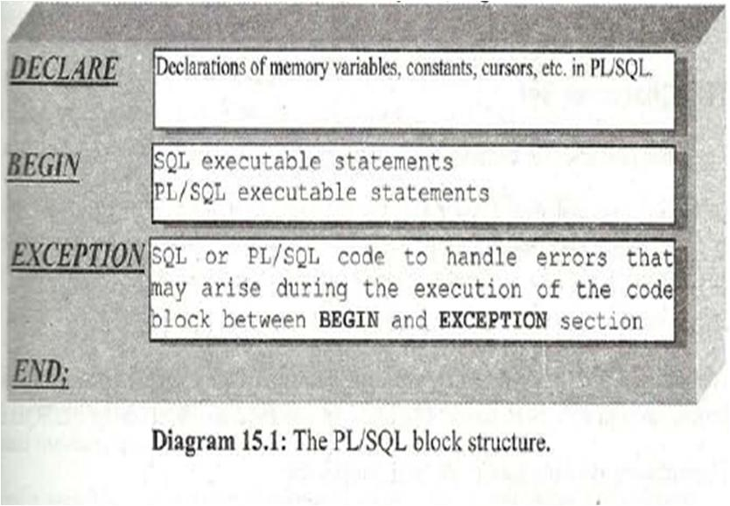

Slide 143
How does the oracle engine Create a Stored procedures & Function?
Following step are preformed automatically by the oracle engine:
Compiles the procedures or function.
Stores the procedures or function in the database.

Slide 144
Errors of Procedures
The Oracle engine compiles the PL/SQL code block.
If an error occurs during the compilation of the procedures or function, or invalid procedures get created.
The Oracle engine display a message after execution that the procedures or function was created with Compilation Error.
The compilation process does not display the errors. They can be viewed using
SELECT * FROM USER_ERRORS;

Slide 145
VARIABLE DECLARATION
In PL/SQL the variable is declared as
A number(10,2);
B number(12,3);
C number(10) :=6;
:= is used to assign the value to variables.
Like in C we use = (equal to sign to assign a value to variable) similarly in PL/SQL we can use := (i.e colon followed by equal to sign)

Slide 146
How to show the output on screen?
In C we use printf() to show output on screen.
In PL/SQL we use
SET SERVEROUTPUT ON
to get output on screen.
dbms_output.put_line(‘printing line’);
It is necessary to on the serveroutput otherwise your output will not be shown on your output screen.

Slide 147
Syntax : Stored procedure
CREATE OR REPLACE PROCEDURE [schema.] <procedure name>
(<Argument> {IN, OUT, INOUT} <Data type> {Is, As}
<Variable> declaration;
<constant> declaration;
BEGIN
<PL/SQL subprogram body>;
EXCEPTION
<Exception PL/SQL block>;
END;

Slide 148
Without Using Procedures
DECLARE
A number(10,3);
B number(10,4);
C number(10,4);
BEGIN
A := &var1;
B := &var2;
C := A+B;
dbms_output.put_line('addition is' ||C );
END;

Slide 149
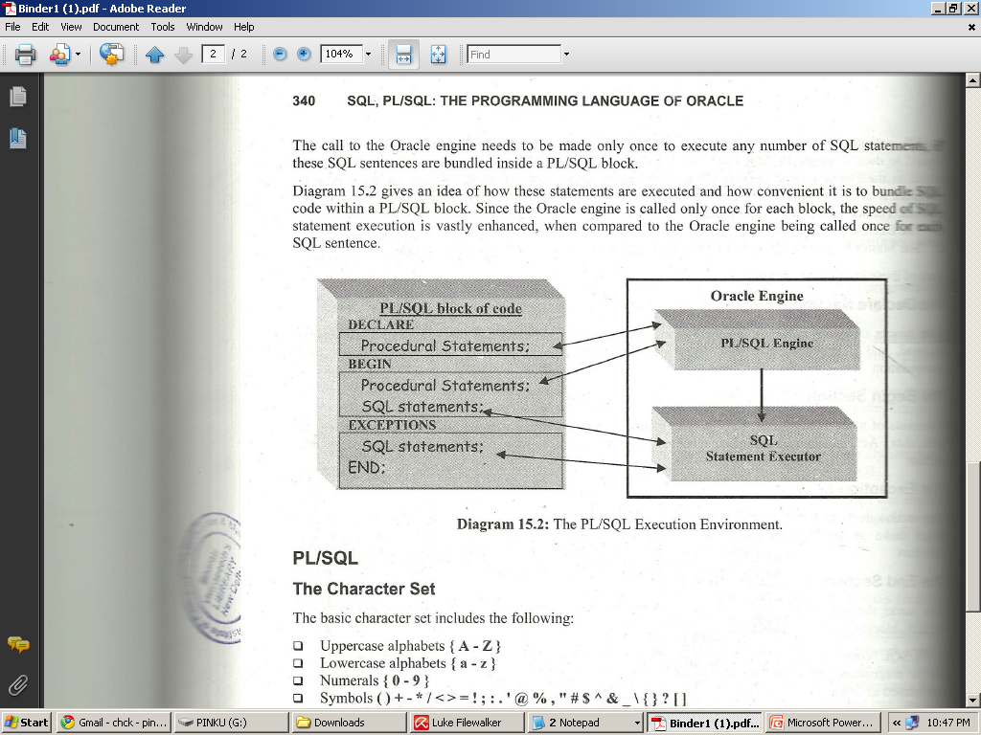

Slide 150
Use of LOOP
DECLARE
i number := 0;
BEGIN
LOOP
i := i+2;
EXIT WHEN i>10;
END LOOP;
dbms_output.put_line(‘loop exited as the value reached to 12’ || to_char(i));
END;

Slide 151
Syntax: function
CREATE OR REPLACE FUNCTION[schema.] <function name>
(<Argument> {IN, OUT, INOUT}
RETURN <Data type> {Is, As}
<Variable> declaration;
<constant> declaration;
BEGIN
<PL/SQL subprogram body>;
EXCEPTION
<Exception PL/SQL block>;
END;

Slide 152
Using Function
create or replace procedure test(a number, b number)
AS
c number(4);
begin
c := a + b;
dbms_output.put_line('result ' || c);
end;
CREATE OR REPLACE Function TestSum(p_Num1 int, p_Num2 Int)
Return int
As
begin
Return p_Num1 + p_Num2;
End;

Slide 153
Advantage of using procedure or function
Both allow you to create bundles of SQL statements that are stored on the server for future use.
This offers you a tremendous efficiency benefit, as you can save programming time by:
Reusing code from one program to another, cutting down on program development time
Centralize maintenance, allowing you to make business logic changes in a single place that automatically affect all dependent applications

Slide 154
Example :
Write a PL/SQL code block that will accept an account number from the user, check if the users balance is less than the minimum balance , only deduct 100/- from the balance. The process is fired on ACC_MSTR table.

Slide 155
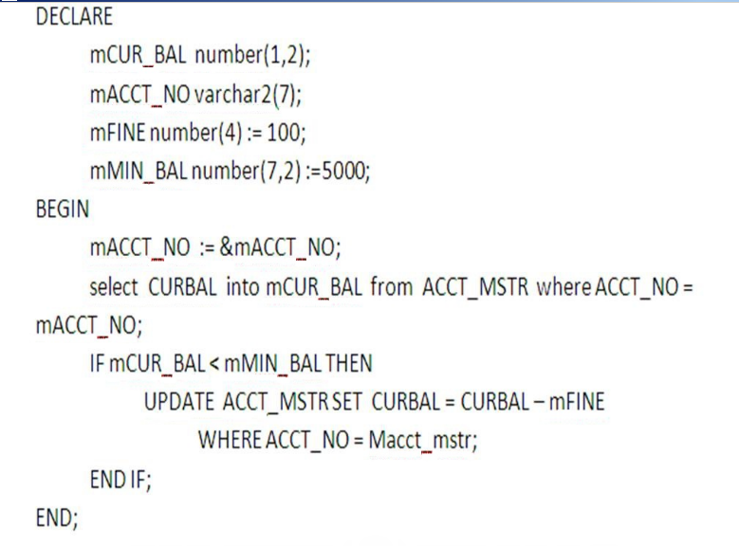
Solution :

Slide 156
Trigger Example
CREATE TABLE "DBA_BANKSYS"."AUDIT_CUST"(
"CUST_NO" VARCHAR2(10), "FNAME" VARCHAR2(25), "MNAME" VARCHAR2(25),
"LNAME" VARCHAR2(25), "DOB_INC" DATE NOT NULL, "OCCUP" VARCHAR2(25),
"PHOTOGRAPH" VARCHAR2(25), "SIGNATURE" VARCHAR2(25), "PANCOPY" VARCHAR2(1),
"FORM60" VARCHAR2(1), "OPERATION" VARCHAR2(20), "USERID" VARCHAR2(20),
"ODATE" DATE);

Slide 157
Contd…
CREATE TRIGGER AUDIT_TRAIL
AFTER UPDATE OR DELETE ON CUST_MSTR
FOR EACH ROW
DECLARE
/* The value in the OPER variable will be inserted into the operation field in the AUDIT_CUST table */
OPER VARCHAR2(8);
BEGIN
/* If the records are updated in the CUST_MSTR table then OPER is set to 'UPDATE'. */
IF updating THEN
OPER := 'UPDATE';
END IF;
/* If the records are deleted from the CUST_MSTR table then OPER is set to 'DELETE'. */
IF deleting THEN
OPER := 'DELETE';
END IF;
/* Insert the old values in the AUDIT_CUST table. */
INSERT INTO AUDIT_CUST VALUES (:OLD.CUST_NO, :OLD.FNAME, :OLD.MNAME, :OLD.LNAME, :OLD.DOB_INC, :OLD.OCCUP, :OLD.PHOTOGRAPH, :OLD.SIGNATURE, :OLD.PANCOPY, :OLD.FORM60, OPER, USER, SYSDATE);
END;

Slide 158
Practice Question:
Ques : Consider the following base relation:-
Project(Project_No,project_name,manager)
Employee ( Emp_No,Emp_name)
Assigned_To( project_no,Emp_no)
Express the following queries :-
Get details of employees (name and number) working on project(comp123).
Get details of employees who work on all projects.
Get employee numbers of Employees working of ‘database’ Projects.
Get the total number of employees handling project (comp343).

Slide 159
Short Questions
What is functional dependency give an example?
What is transitive dependency give an example?
Briefly describe an example of a database in 3 NF?
What is lossless join Property?
Describe Oracle 8 architecture in points with diagram?

Slide 160
References
TEXT:
Korth, Silberschatz, “Database System Concepts”, 4th Ed., TMH, 2000.
Date C. J., “An Introduction to Database Systems”, 7th Ed., Narosa Publishing, 2004
Data Base Management System by Navathe

